Slide 1







Stack Overflow Developer Survey 2019
Mckinley Petalver
January 3, 2024
https://www.linkedin.com/in/mckinleypetalver/

Slide 2



OUTLINE
Executive Summary
Introduction
Methodology
Results
Visualization – Charts
Dashboard
Discussion
Findings & Implications
Conclusion
Appendix

Slide 3

EXECUTIVE SUMMARY
Analysis of recent data collected from diverse demographic groups within the technological professional community sheds light on both current and future trends in programming languages, databases, web frameworks, and platforms.
Current Trends:
Dominance of Python, HTML/CSS, and JavaScript in programming languages.
Prevailing use of mySQL, with Windows, Linux and Docker leading in platform choices.
Future Aspirations:
Growing interest in Kotlin and Go for programming languages.
Emerging curiosity in PostgreSQL, MongoDB and Redis for databases and React.js for web frameworks.

Slide 4

INTRODUCTION
Explore current data trends using visualizations
Uncover patterns for future trends
Spotlight on respondent demographics for a nuanced perspective.
Age
Gender
Country
Education Level

Slide 5

METHODOLOGY
Data Collection
Web scraping
APIs
Request library
Data Wrangling
Exploratory Data Analysis
Data distribution
Outliers
Correlations
Data Visualization
Graphs

Slide 6
RESULTS

Slide 7
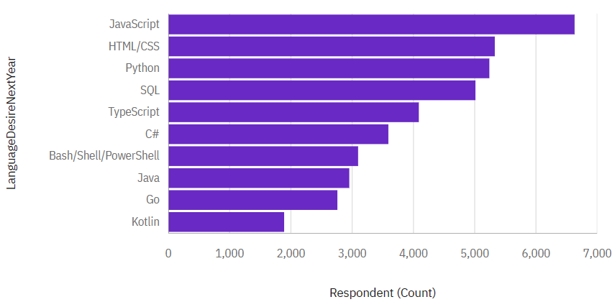
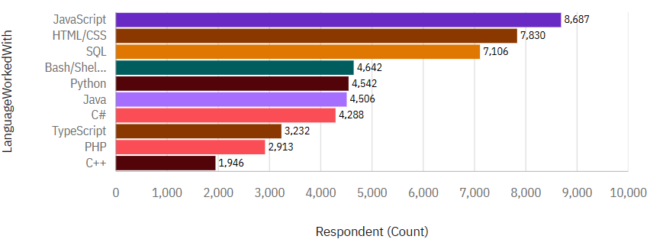
PROGRAMMING LANGUAGE TRENDS
Current Year
Next Year

Slide 8
PROGRAMMING LANGUAGE TRENDS - FINDINGS & IMPLICATIONS
Findings
JavaScript and HTML/CSS maintain their top positions, albeit experiencing a slight decline.
Decline in Java and PHP.
Uprising Kotlin and Go languages
Implications
Programmers shifting to newer languages.

Slide 9
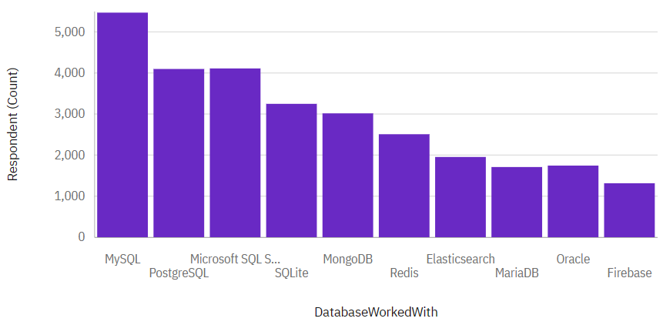
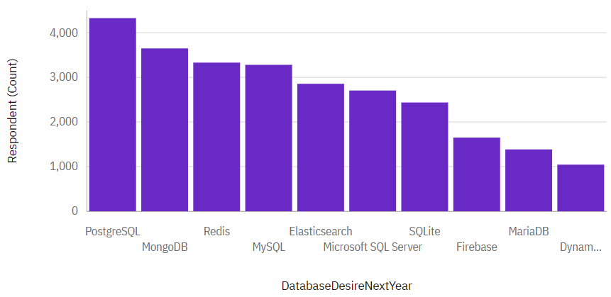
DATABASE TRENDS
Current Year
Next Year

Slide 10
DATABASE TRENDS - FINDINGS & IMPLICATIONS
Findings
Decline in mySQL
Huge rise in PostgreSQL and MongoDB
Slight rise in Redis
Implications
Databases trend shift.
Establishment of PostgreSQL and MongoDB in the market.

Slide 11

DASHBOARD
https://drive.google.com/file/d/1Z75XlH2adF4QDrmnHR7lVjKNGol4vh27/view?usp=sharing

Slide 12
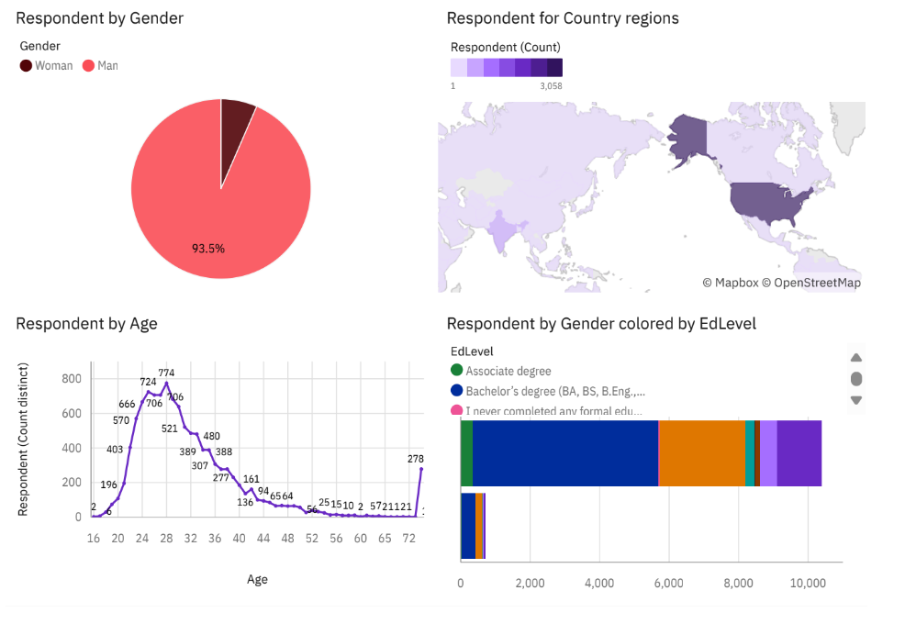
DASHBOARD

Slide 13
DISCUSSION

Slide 14
OVERALL FINDINGS & IMPLICATIONS
Findings
JavaScript and HTML/CSS persist at the forefront but show a slight decline.
MySQL usage sees a decline.
Kotlin, Go and Redis are on the rise.
Implications
Programmers are adapting to newer languages.
Organizations may need to consider the evolving landscape for skill requirements.
Significant shifts in database preferences call for industry adaptation.

Slide 15

CONCLUSION
Evolving Landscape: The findings reflect a dynamic and evolving landscape in both programming languages and databases, underscoring the industry's responsiveness to emerging technologies.
Adaptation Imperative: Professionals and organizations must adapt to the changing trends, embracing newer languages and databases to stay relevant and competitive in the ever-evolving tech ecosystem.
Strategic Considerations: The identified trends provide valuable insights for strategic decision-making, guiding individuals and businesses in aligning their skills and infrastructure with the current and future demands of the tech industry.

Slide 16

APPENDIX

Slide 17
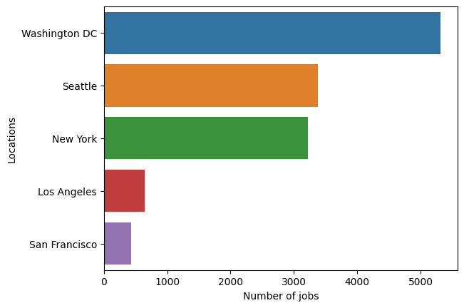
JOB POSTINGS

Slide 18
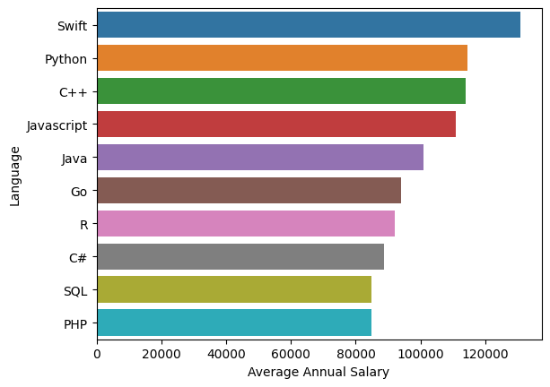
POPULAR LANGUAGES

